Slide 1
Course 3: Introduction to ML Strategy
-Coursera Notes

Slide 2
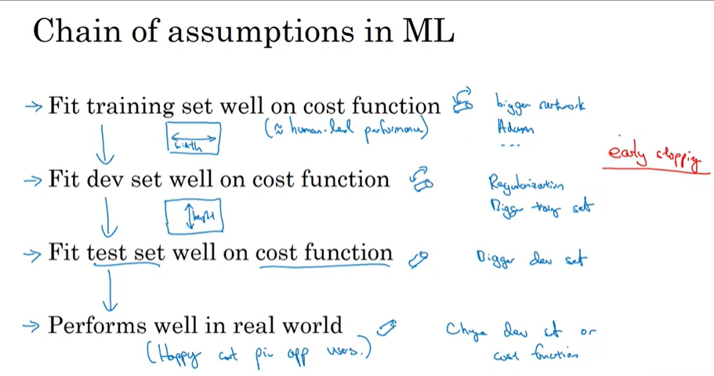
Orthogonalization
It is a process of what parameters to tune in a model.
Better not to use early stopping because it will not reduce the cost function/error. It will fit training set less well.

Slide 3
Single Number Evaluation Metric
Between classifier, precision and recall, it is better to use one single number evaluation metric.
Precision is ; of all training examples, what % of examples are actually cats.
Recall is of all the images that are really cats, what % of images were correctly recognized by your classifier.
Therefore, it best to use F1 Score (combines precision and recall) (it is the average of both scores)
Having a well defined dev set + a single number evaluation matrix allows you to classify better. Speeds up the iterative process of your machine learning model.

Slide 4
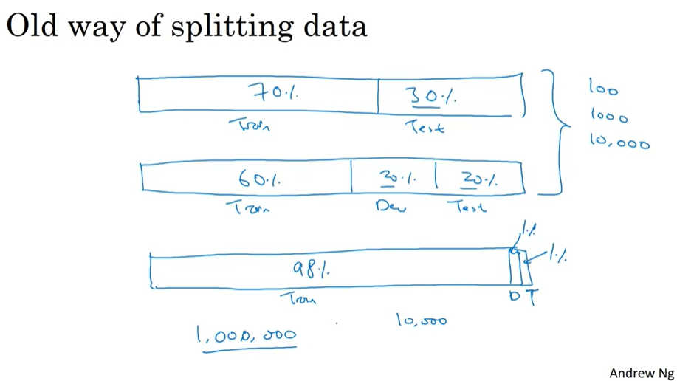
Train/Dev/Test Set Distributions
The earlier way of splitting Train, Dev and Test was 60%-20%-20%.
However, with the emergence of big data with billions of data, it is better to take the following split for train-dev-test set;
98%-1%-1%
The test set needs to be big enough to give high confidence in the overall performance of the model.
A lot of times a test set is not used since we have Dev set. But its better to use a test set to have unbiased estimate.

Slide 5
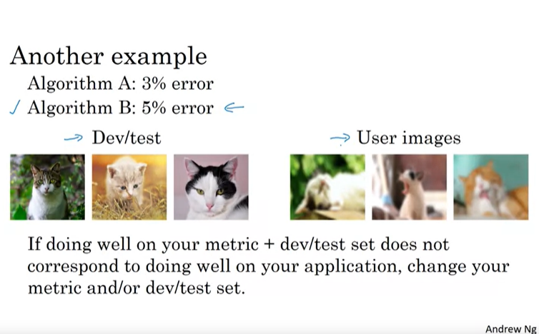
When to change dev/test sets and metrics

Slide 6
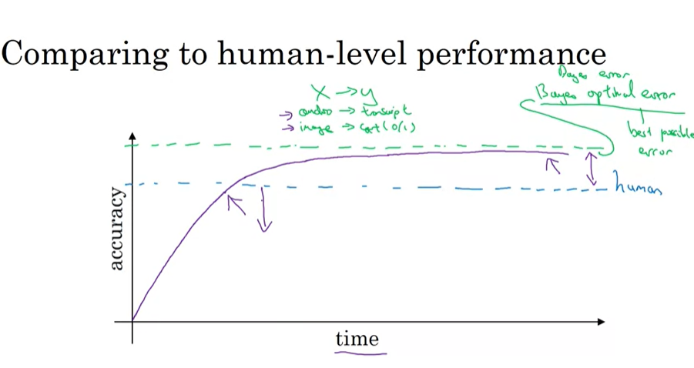
Comparing to Human-level performance
When Comparing ML models to human level tasks such as recognizing cat pictures; initially the algorithm tends to perform well but with time they surpass human level performance and progress and accuracy slows down.
Once you keep optimizing the algorithm with bigger data, the performance increases but never passes a theoretical limit which is called the Bayes Optimal Error (best possible error).
Bayes error is the best theoretical function for mapping from x to y that can never be surpassed.
As long as ML is worse than Humans, you can;
Get labelled data from humans.
Gain insight from manual error analysis: why did the person get this right?
Better analysis of bias and variance

Slide 7
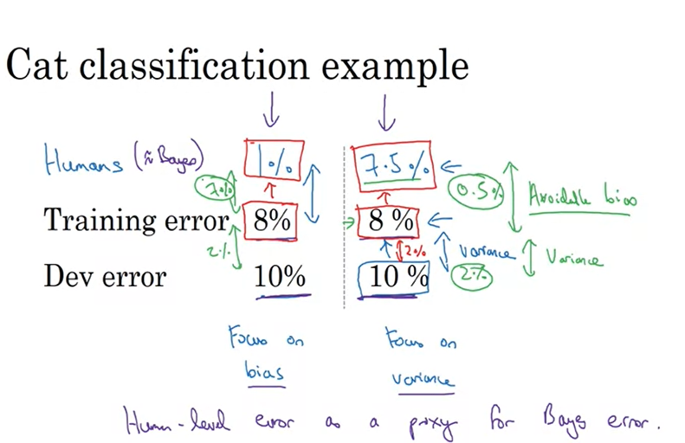
Avoidable Bias
Avoidable bias is the difference between the training error and the bayes error (human error) where human level error is used as a proxy for bayes error.
Keep training the model till it reaches the bayes error as doing better than the bayes error can lead to problems of overfitting.
Whereas the difference between the training error and dev error is variance.

Slide 8
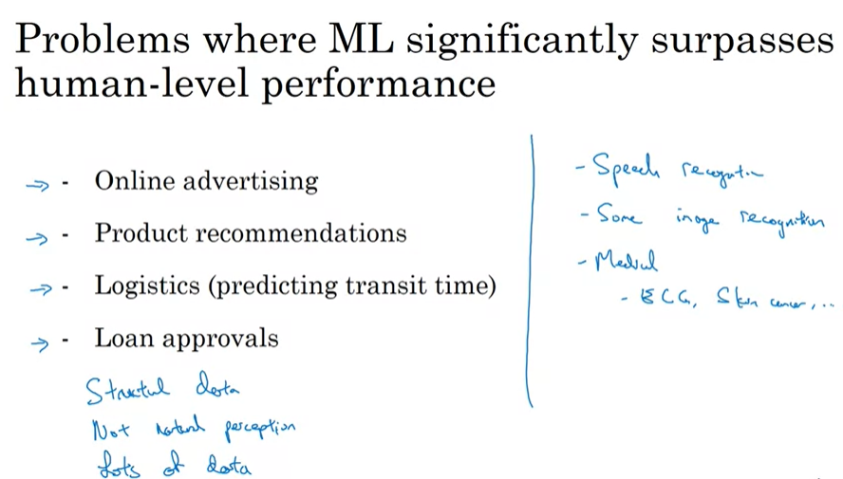
Surpassing Human Level Performance

Slide 9
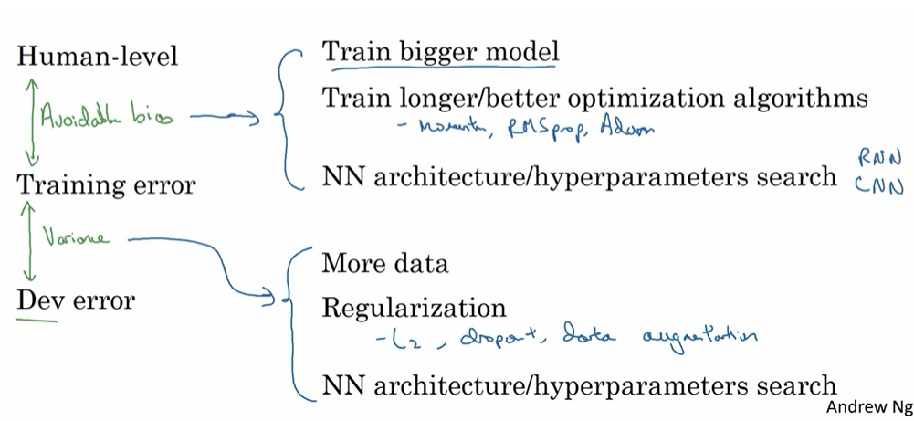
Improving your Model Performance
Look at the difference between training error and bayes error to understand the avoidable bias to see how much of your training model can be improved.
Look at the difference between train error and dev error as an estimate of how much of a variance problem you have. (how much harder should you be working to make your performance generalize from training to dev set.

Slide 10
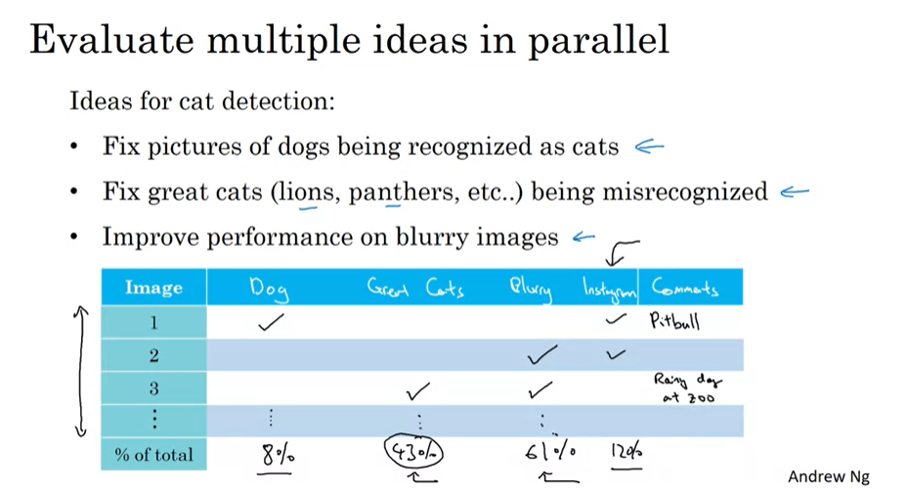
Week 2
Error Analysis: Manually examining how the algorithm is performing, what mistakes it is making.
For example, to do an error analysis,
- Manually get 100 mislabeled dev set examples
-count up how many are dogs
If, out of a mislabeled 100 examples, only 5 are correctly classified as dogs. This means that if only 5% of errors are dog pictures, then the best you can do is going down from 10% to 9.5% , implying a 5% relative decrease in error.
Ceiling on the performance-what is the best case (best error).
To summarize; to carry out error analysis look at your dev set for mislabeled examples for false positives and false negatives and count up the number of examples that fall into each category that helps you prioritize and gives an insight into what to do next.

Slide 11
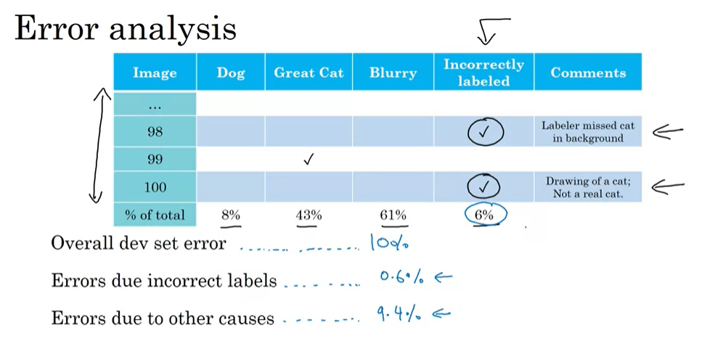
Cleaning up Incorrectly labelled data
If you find that your algorithm has mislabelled examples, you can do the following;
DL algorithms are quiet robust to random errors in the training set. Consider your training set and see if the errors are reasonably random, then it is probably ok to leave the errors as they are.
If you have incorrectly labelled examples in your Dev/Test set, do an error analysis and add an extra column of incorrectly labelled data in the error analysis so that you can find out the percentage of errors due to incorrect labels.
Only if working on the percentage of mislabelled images makes a significant difference to the ability of the algorithm to evaluate on your dev set, then you can fix the incorrect labels, otherwise leave it.
Look at the overall dev set error.
If you decide to go to dev set and manually assess the mislabelled examples to fix them;
Apply same process to your dev and test sets to make sure they continue to come from the same distribution.
Consider examining examples your algorithm got right as well the ones it got wrong.
Since train and dev/test data may now from slightly different distributions, it is not required to fix the mislabelled examples on the training set. Just do it on the dev/test set.

Slide 12
Build your first system quickly and then iterate
First set up a dev/test set and metric (deciding where to set up target)
Build initial system quickly (to see how well you are doing against your dev/test set and evaluation metric)
Use bias/variance analysis and error analysis to prioritize next steps.
To summarize, if it’s your first application, its always better to not over think it and build your first system quickly and then use that to iterate.

Slide 13
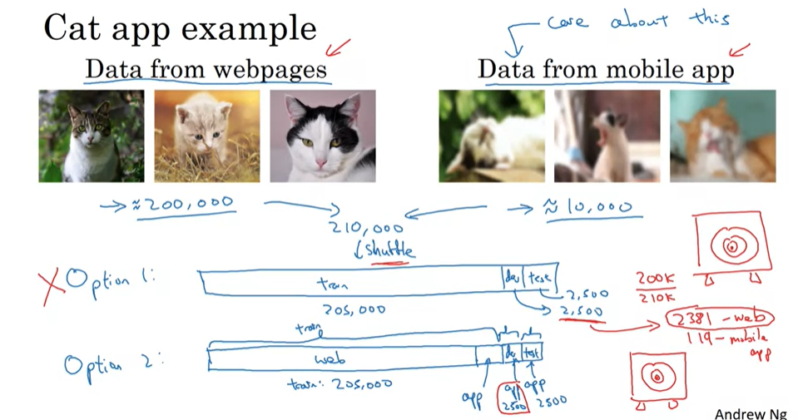
Training and Testing on Different Distributions
Allowing your training set to come from different distributions than your dev and test sets allows you to have much more training data which will improve the learning algorithm.

Slide 14
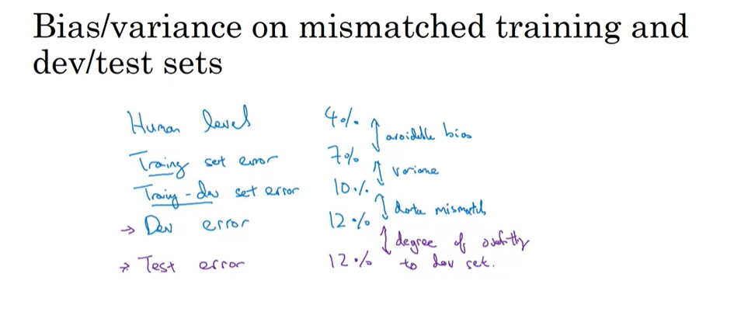
Bias and Variance with Mismatched Data Distributions
When you carve out a small proportion of training set , that you do not use for training the NN but it comes from the same distribution as Training set, it is called Training-Dev set.
When you have only 1% error on training and 9% error on Train-Dev, and on dev set the error is 10% you encounter the problem of variance which means that the algorithm is not able to generalize well on train-dev which is coming from the same distribution.
However when training has 1% error, training dev set has 1.5% error and Dev error jumps to 10% error, there is a problem of data mismatch because training dev and dev sets are coming from different distributions.
On the other hand, a situation of high bias/avoidable bias occurs when error on all 3; training, training dev and Dev sets are high for eg, 10, 11, 12% respectively.
Dev set and test set come from the same distributions.

Slide 15
Addressing Data Mismatch
If there is data mismatch,
Do a manual error analysis, look at the training set and dev set to look at how different their data distributions are.
Dev set can also be more noisy than your train set. One thing you can do is try to make your training set similar to your dev set.
See if there are some ways to get more training data that looks like your dev set and one of the ways is through artificial data synthesis.
artificial data synthesis does boost performance-be aware whether you might be accidently simulating data only from a tiny subset of the space of all possible examples.

Slide 16
Transfer Learning
You can take knowledge that the NN has learned from one task and apply that to other tasks.
For example if you are training examples for an image recognition task(recognizing cats), you train all the usual parameters, and then take the last output layer in the NN and delete that and delete the ways it is feeding into the last output layer.
Create a new set of randomly initialized weights just for the last layer and have that output radiology diagnosis. This way you implement transfer learning by swaping in a new dataset XY where x are the radiology images and y are the diagnosis. Initialize the layer weights
And then you re-train the dataset on the radiology images. If the dataset is small then you could just retrain the last layer and keep the other parameters of other layers fixed.
But if you have a bigger dataset, you can retrain all the parameters in the network. And if you retrain all the parameters in the network, then this initial phase of training is sometimes called pre-training.
But if you are updating all the ways afterwards, then training on the radiology data is called fine-tuning.
Transfer learning enables the algorithm to learn enough and recognize what images look like and then adapt that to radiology images. (it can learn and train faster to a new NN).
But transfer learning only makes sense if you have a lot of data from the problem you are transferring from and relatively less data to the problem you are transferring to. (you need a lot of data to learn from to learn imp features of recognizing particular images, audio, text etc). The opposite of this would not work.

Slide 17
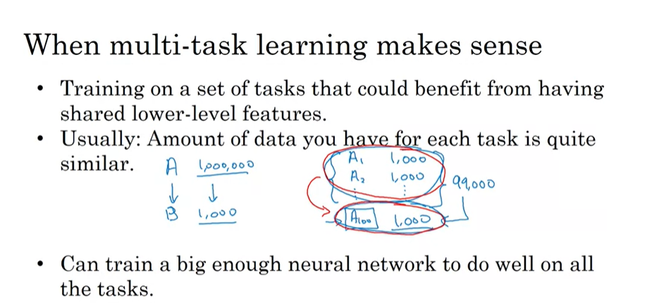
Multi-Task Learning
Where as in transfer learning, there is a sequential process of learning where you learn from Task A to Task B, Multi task learning, learning takes place simultaneously and each of these tasks helps all of the other tasks.
Training 1 NN to do 4 tasks at the same time works better than training 4 separate NNs to 4 individual tasks. That’s the power of multi-task learning
Multi-task learning can also train NN to do 4 tasks at the same time where some examples are fully labelled and some are question marks. This happens by omitting the examples where there are question marks and does a summation over only the labelled examples.
However, in practice transfer learning works more than multi-task learning.

Slide 18
End to End Deep Learning

